Slide 1
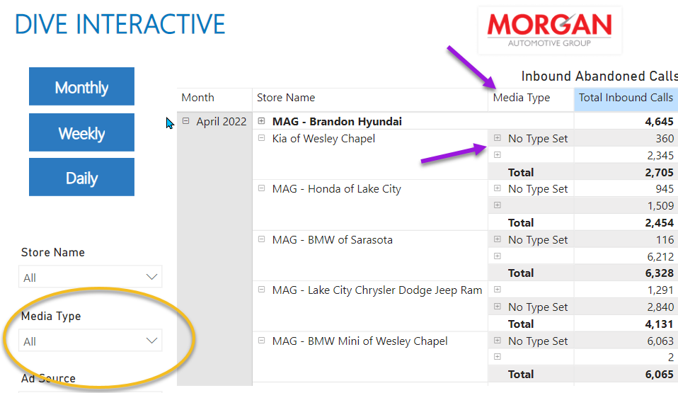
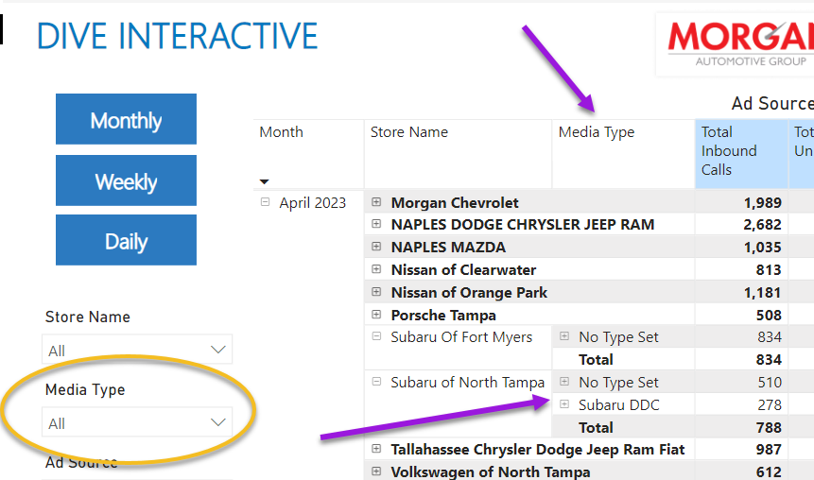
Media Type or Marketing Provider
In the new PowerBi Enterprise report there is a category called Media Type. This category pulls its data from a field in CR360 assigned to a tracking number called Marketing Provider. This field can only be updated or changed in CR360 and no where else. If a client wants to categorize their lines with Media Types how would they set the categories?

Slide 2
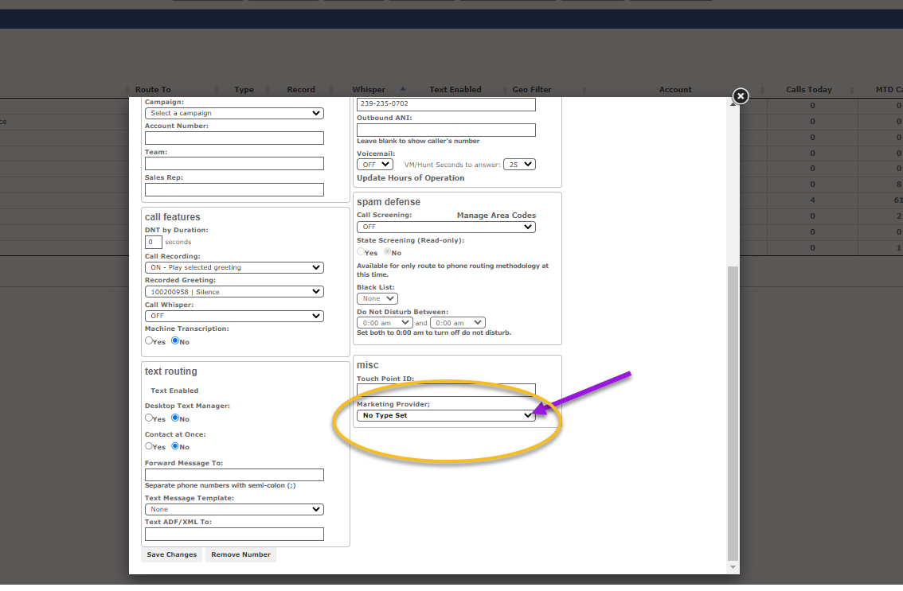
Marketing Provider - Found in CR360 - Tracking Numbers, Phone Numbers and then Edit a specific tracking number

Slide 3
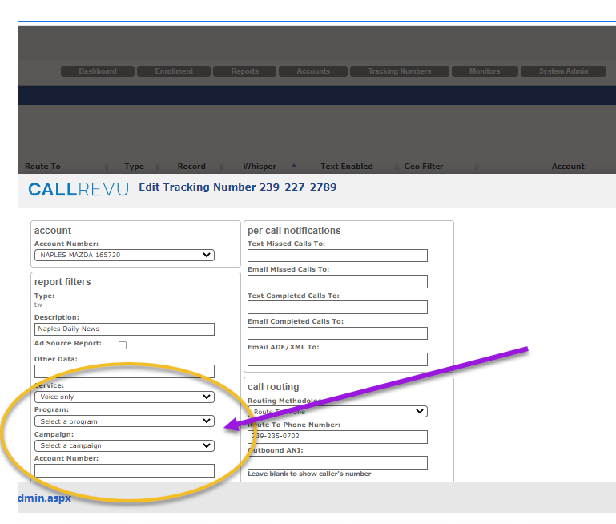
In CR360 on tracking numbers there are also 2 other categories Program and Campaign – I am not sure what they are used for now and Matt H might know but could these also be used to allow tracking numbers to be categorized and how would the customer update these?

